Slide 1
IT628: Systems Programming
IPC with shared memory segments

Slide 2
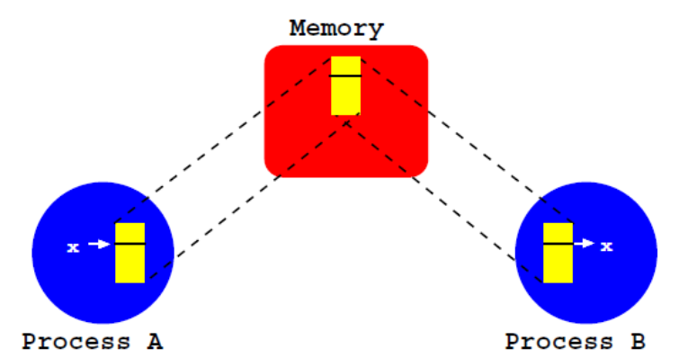
Shared memory segments
Normally, a region of memory is associated with exactly one process
A shared memory segment is a memory region shared by two or more processes
  when one process writes to the segment, the other also sees the change
Most efficient of all the IPC mechanisms

Slide 3
System calls
The processes begin by allocating the segment
  shmget(): the memory segment created is part of physical memory
Then, each process must map the segment in a memory address, so that, it can use the segment
  shmat()
After its usage, each process must release the mapping done in the previous step
  shmdt()
Finally, one of the processes must remove the segment
  shmctl()

Slide 4
What about synchronization
A shared memory segment provides no synchronization of its own
For synchronization purposes use semaphores!

Slide 5
Allocating segments
int shmget(key_t key, size_t size, int flags)
shmget() allocates a new shared memory segment, or gets a reference to an existing one, and returns its id
  key is the identifier of the requested segment
    other processes can access the same segment if they present the same key
  size defines how many bytes we want in the memory segment
  flags specifies the type of allocation: IPC_CREAT indicates that the new segment must be created (if it does not exist)
If it is not possible to allocate segment, then it returns -1

Slide 6
Mapping segments
void * shmat(int shmid, void *addr, int flags)
shmat() allows the mapping of a shared memory segment from a memory address within the address space of the process
  shmid is an integer that identifies the segment (obtained with shmget())
  addr is the desired memory address, or NULL if we allow the OS to choose the address
  flags specifies the option of the mapping
returns the address of the memory in which segment was mapped, or -1 on error

Slide 7
Freeing segments
int shmdt(void *addr)
shmdt() frees the mapping, thus the corresponding segment is no longer associated with a memory address
  addr is the initial memory address associated with the segment to be freed
returns 0 on success, -1 on error

Slide 8
Removing segments
When a process calls shmdt(), the mapping is freed
However, the segment is not removed
shmctl() must be explicitly called by one of the processes

Slide 9
Removing segments
int shmctl(int shmid, int cmd, struct shmid_ds *buf )
shmctl() removes the shared memory segment
  shmid is the integer that identifies the segment
  cmd should be IPC_RMID
  buf should be NULL
returns 0 on success, -1 on error

Slide 10
Code demos
shm1.c
memory segment shared by multiple processes (same program)

Slide 11
Demo
shm2.c and shm3.c
memory segment shared by multiple processes (different programs)

Slide 12
Demo
shm4.c and shm5.c
using shared memory segment to share semaphore between multiple processes

Slide 13
(Mini) Exercise 2
Due: 07 April, 11:55 pm, google classroom
Using shared memory and semaphores, write a program shms.c to do the following:
Parent process P takes as input 10 integer elements from the command line
P places the 10 elements into an integer array in shared memory
P creates two child processes C1 and C2
C1 sorts the first give elements and C2 the next five elements using quicksort (provided in C standard library). Now, the first five elements in shared memory are sorted, and so are the next five elements

Slide 14
(Mini) Exercise 2
C1 computes the minimum input element by comparing the 1st elements of both the sorted partitions. Then C1 prints the minimum element and exits
C2 computes the maximum input element by comparing the 5th elements of both the sorted partitions. Then C2 prints the maximum element and exits
P waits (using wait) for both C1 and C2 to exit

